Slide 1
WELCOME!
PLEASE SIGN IN ON YOUR MOBILE DEVICE NOW
Go to: www.mytimetotri.com/signin
Enter your name, email, and partner code (ask the host for the code)
www.mytimetotri.com

Slide 2
GETTING STARTED IN TRIATHLON
Three sports. One ﬁnish line. Great resources to help you get there.
www.mytimetotri.com

Slide 3
TRIATHLON:
A SPORT FOR EVERYONE
Swim Bike, and Run!
No matter the distance, if you cross the finish line, you are a triathlete! There is a place for everyone in the sport regardless of your experience, ability, or age.
www.mytimetotri.com

Slide 4
“DO SOMETHING NEW
EVERYDAY”
That’s from Marcus Cook, a Time to Tri Ambassador.
Marcus used triathlon to lose 268 pounds – and counting. His main goal wasn’t simply to finish, it was to walk every day for two weeks, for just 20 minutes. Triathlon offers a unique and motivating way to try something new, jump-start your fitness, and boost your health.
www.mytimetotri.com

Slide 5
WHY WE LOVE TRIATHLON
The Sport. Triathlon is beginner-friendly, welcoming and utterly rewarding. It’s a meaningful accomplishment you’ll be proud of for life.
The Community. Triathletes (even the pros) are incredibly supportive, encouraging, and motivating.
The Fitness. Triathlon training provides terrific, low-impact cross-training. You’ll feel better, have more energy, and live a healthier lifestyle.
www.mytimetotri.com

Slide 6
YOU CAN DO EACH SPORT
Can you swim? Can you bike? Can you run?
Congratulations, you have what it takes to be a triathlete. Even if you have never done these sports, there is always time to tri something new.
www.mytimetotri.com

Slide 7
GET CONNECTED
Learn The Basics
Becoming a triathlete is easier than you think.
Learn the basics
Find a local tri club to get started
Get a coach for extra help. Beginner resources at mytimetotri.com can help you to get started
www.mytimetotri.com

Slide 8
GET COMMITTED
Find Time To Train & Stick To It
Triathlon takes less time to train for than you might think.
You can do it in just 5 hours per week.
Review your calendar and commitments and identify training opportunities
Commit to 5 hours a week and stick to it
Balancing work, life and health is manageable if you plan properly
www.mytimetotri.com

Slide 9
GET GEAR
Get The Basics
You probably already have the basics:
a swimsuit, a bike, and a pair of running shoes.
Lace up your running shoes
Get a pair of goggles and start swimming
Ride what you have: any bike is fine, even a bike at the gym
www.mytimetotri.com

Slide 10
GET SWIMMING
Get Comfortable In The Water
If swimming the length of a pool seems overwhelming,
you’re not alone.
Get comfortable in the water
Find a local pool
For extra help, join a swim class
www.mytimetotri.com

Slide 11
GET TRAINING
Get Going & Set a Goal
Get a training plan and sign up for a race to get going.
Download your free training plan
Join a local run club or spin class
Sign up for your first triathlon and put the date on your calendar
Share the news with your friends and family so they can cheer you on!
www.mytimetotri.com

Slide 12
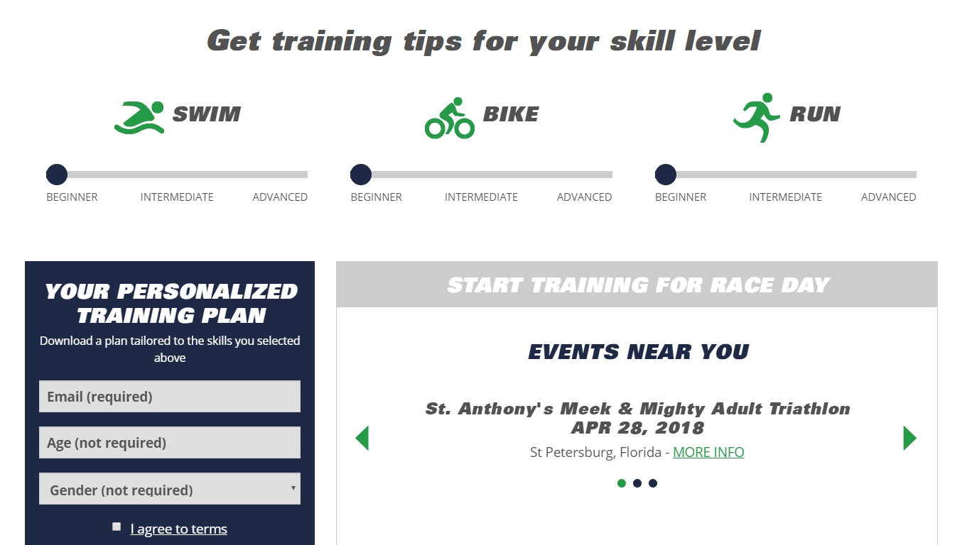
GET YOUR FREE TRAINING PLAN AT mytimetotri.com
www.mytimetotri.com

Slide 13
SEE YOU AT THE FINISH LINE!
www.mytimetotri.com

